Slide 1
Consumer Complaint Classification
Team Members:
Nikhil Bhoneja
Dhanesh
Dennis
Kshitij

Slide 2

Contents
Dataset Description
Objective
Preprocessing / Feature Engineering
Classification Algorithms Used
Results

Slide 3
Aim
Problem Statement -
Each week, the Customer Financial Protection Bureau receives and forwards thousands of consumer complaints on financial products and services to firms. Utilize the provided complaint description to file each complaint in the correct product category
Objective -
These are legitimate worries regarding banking services. We have a challenge with supervised text classification because each complaint is associated with a particular product. To better predict how future complaints would be categorized, we analyzed historical data using a range of machine learning techniques (i.e., classify the complaint in one of the product categories)
The whole financial industry is represented in the dataset, which includes customer complaints about Credit Reports, Student Loans, and Money Transfers, among others

Slide 4
Dataset description
Target Column – ‘Consumer Complaint’
Raw data -
Number of columns - 19
Number of rows - 3,572,479
Rows having missing data / Null Values – 2,283,688
Target Feature - ‘Consumer Complaint’
Data after EDA -
Number of columns - 02
Number of rows – 277,814
Columns dropped - 17
Data distribution of test and training -
20% for test
80% for training

Slide 5

Preprocessing and Feature Extraction
Records with null values in the relevant fields were removed
The distribution of this data is highly skewed, so to fix that problem, up to 20,000 records were randomly sampled from each class rather than utilizing the full dataset
Standard tokenization and preprocessing was used: all characters were set to lower case, punctuation was removed, English stop words were removed
The preprocessed text was converted to numerical data through TF-IDF with 500 features
Notes:
As mentioned last slide, records with null values were removed from the dataset, leaving us with just under 1.3 million rows
The distribution of these entries is highly skewed, which makes the data difficult to work with.
In order to remedy this problem, 20,000 records were randomly sampled from each class where applicable. This left us with about 250,000 to use in our analysis
We used standard tokenization and preprocessing steps: making the text lower case, removing punctuation, removing stop words, etc.
We used TF-IDF to convert the text to numerical data, and we settled on using the top 500 tokens to represent the complaints

Slide 6
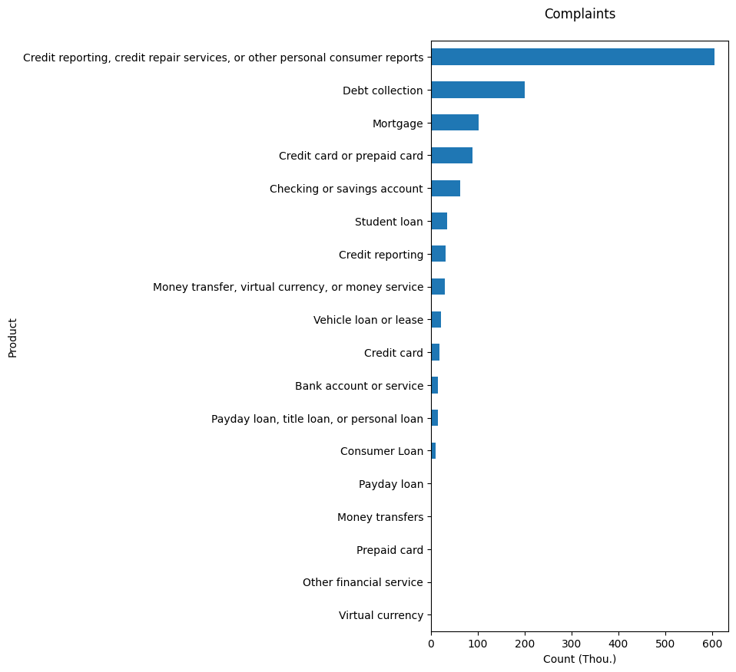
Data Distribution
Before Sampling
Notes:
So this is the distribution of the data before any preprocessing steps. As you can see, the credit reporting class dominates the dataset, while some others like Virtual currency have relatively few records

Slide 7
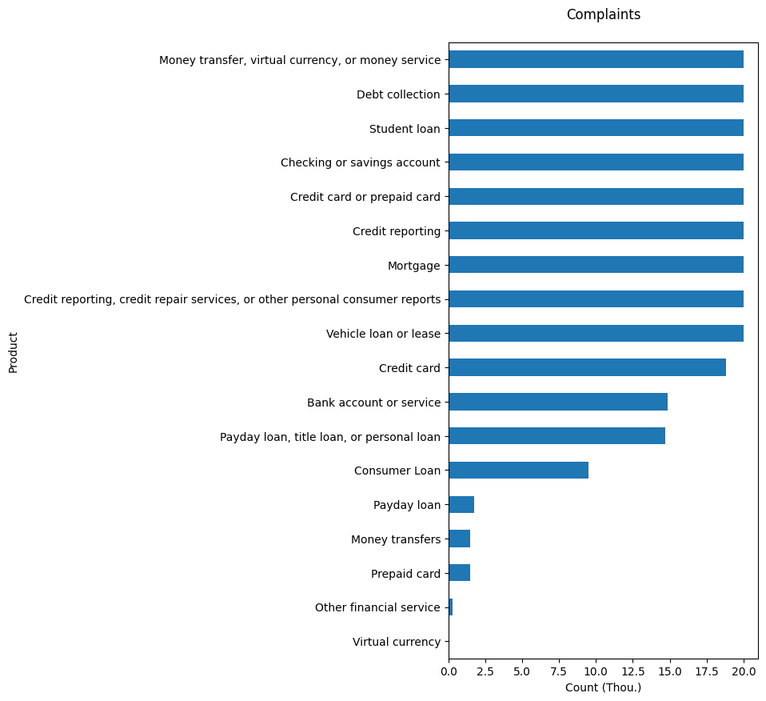
Data Distribution
After Sampling
Notes:
After we sample the data, our dataset is much cleaner. Though more work can be done to make it more uniform, through upsampling and other techniques, this was good enough for us to move forward.

Slide 8

Example Features
Token Product | Credit | Loan | Account
Credit Card | 0.114576821 | 0.002832385 | 0.073291623
Student Loan | 0.02764716 | 0.135500216 | 0.02764716
Credit Reporting | 0.132185098 | 0.011558177 | 0.052718398
Prepaid Card | 0.014008531 | 0.000836919 | 0.065051648
Notes:
Here are a few examples of the TF-IDF features after taking the mean with respect to each class.
The word credit receives a higher score for credit-related products, like credit card and credit reporting, while it receives a low score for other products.
Similarly, the word Loan has very low scores for credit card and prepaid card, but a higher score for student loans.
This shows us that our feature extraction procedure was good.

Slide 9
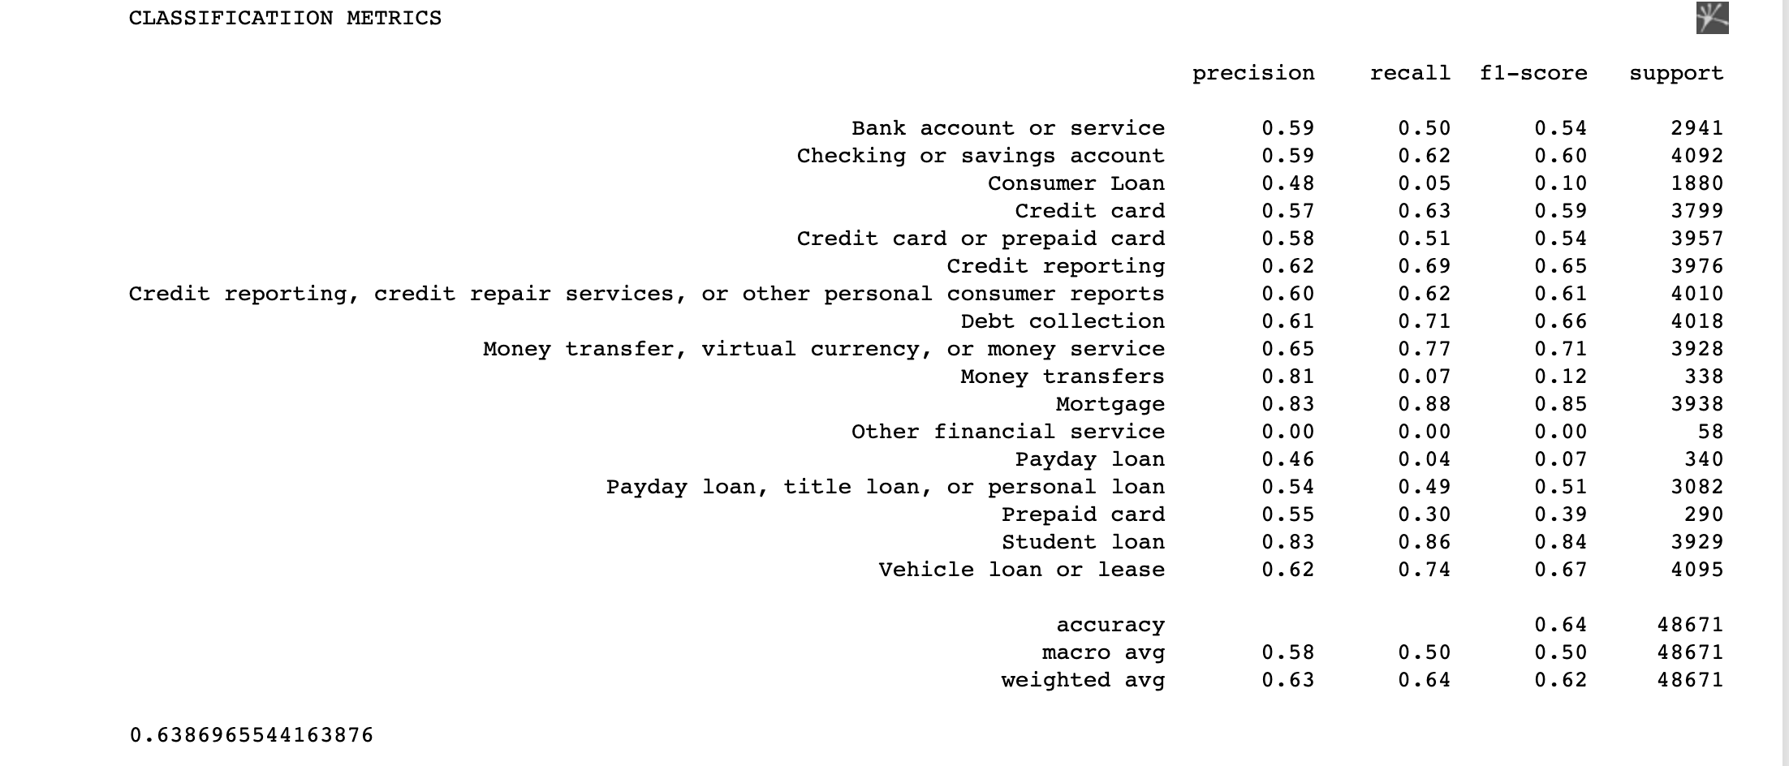
Linear SVC
SVC stands for Support Vector Classifier, a popular machine learning algorithm used for binary classification tasks. It aims to find an optimal hyperplane that separates data points belonging to different classes
Models Implemented

Slide 10
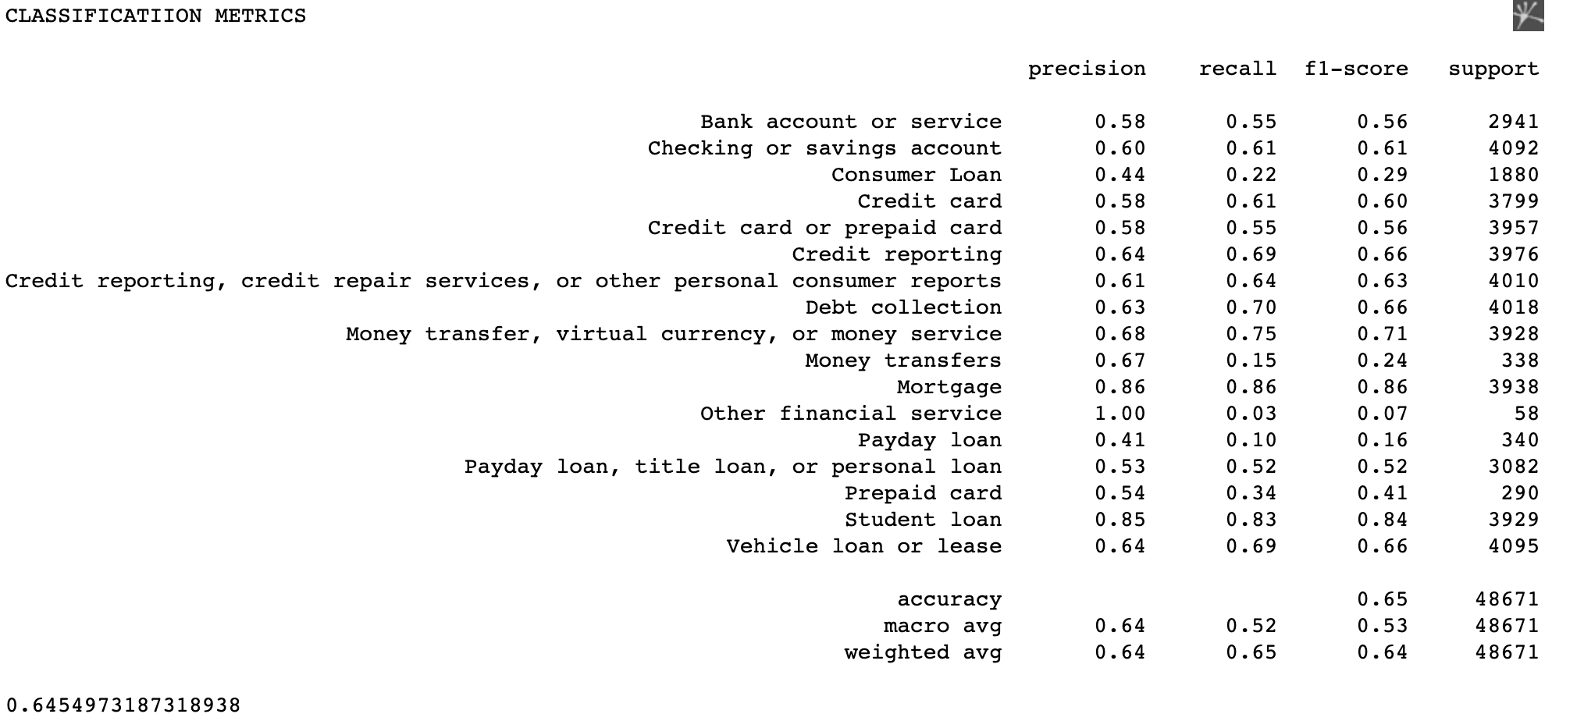
Logistic Regression
Logistic regression is a statistical model used for binary classification, where the output is a probability between 0 and 1. It estimates the relationship between the independent variables and the dependent variable using the logistic function
Models Implemented

Slide 11

Multinomial Naïve Bayes Classifier
The Multinomial Naive Bayes classifier is a probabilistic model used for multi-class classification tasks. It assumes that the features are conditionally independent given the class and predicts the class with the highest probability based on Bayes' theorem
Models Implemented

Slide 12

Random Forest Classifier
Random Forest Classifier is an ensemble learning method that combines multiple decision trees to make predictions. It uses random subsets of features and bootstrap sampling to reduce overfitting and provides accurate and robust predictions
Models Implemented

Slide 13
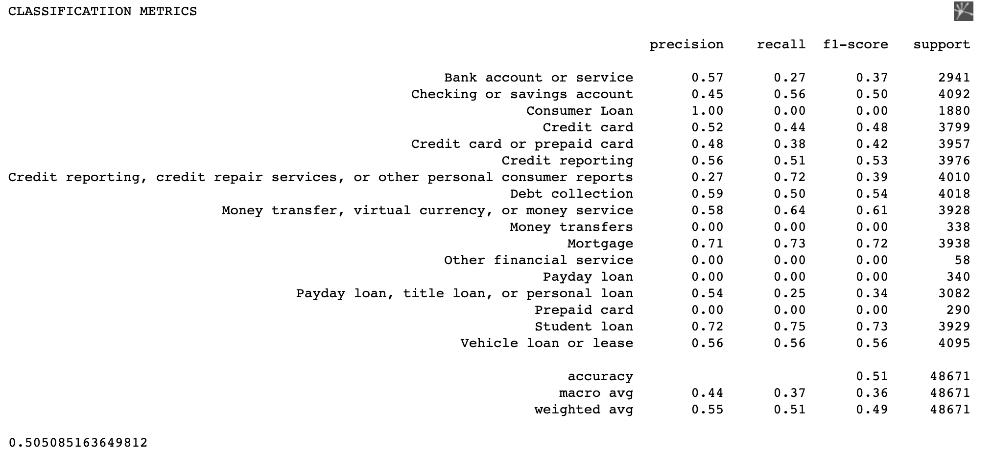
K-Nearest Neighbor Classifier
K Nearest Neighbor (KNN) Classifier is a simple algorithm that classifies new data points based on the majority class of their K nearest neighbors in the feature space. It does not require any training phase but can be sensitive to the choice of distance metric
Models Implemented

Slide 14
Conclusion
Model | Accuracy
Linear SVC | 0.64
Logistic Regression | 0.65
Multinomial NB | 0.60
Random Forest | 0.65
K-Nearest Neighbor | 0.51

Slide 15
Thank you!

